Slide 1

REVIEW-02
GROUP 2 – ONLINE BANKING SYSTEM

Slide 2
CONTENT
INTRODUCTION
ENHANCED ER DIAGRAM
NORMALISATION
TABLE CREATION AND INSERTION OF RECORDS
USER INTERFACE DESIGN
CONCLUSION

Slide 3
INTRODUCTION
"Online Banking System" is a main and important thing in our day-to-day life. In the past review, we made an abstract, Schema diagram, and ER diagram. Creating an interface for online banking involves data needs. In this Review 2, we made a normalized relationship between the tables up to third normal forms, thus coming upon twenty finalized tables with sample data in it and a sample user interface design that reflects our fair website.

Slide 4
PROBLEM DEFINITION
With banks being just a few clicks away; online banking allows customers to access their bank accounts from anywhere; 24/7 securely and conveniently. A new age online banking system allows customers to conduct day-to-day money transfers, direct deposits, bill payments to be carried out efficiently with utmost ease and comfort. With the concept of banking turning online, the users can keep a good eye, monitoring all their balance and pending transactions in real-time. In order to deal with the banking tasks online, a database to record all the details is very much needed along with a user interface for both the ends to interact.
This platform is designed to serve as a one-stop solution for both the customers and administrators.

Slide 5
AIM
The main aim of this project is to design and develop a database for the bank to maintain records of various branches of the bank across the country, administrators’ details as well customers' account details, account statements, transaction details, loan details (if availed by the customer) and bill payments in order to nurture the needs of an end banking user by providing various ways to perform banking tasks online.

Slide 6
FUNCTIONALITIES
Provides with individual accounts (savings or current account or both) to customers in order to preform banking tasks online.
Provides a registration link for new customers as well as a login link for existing customers to access their accounts.
Allows customers to deposit money in their accounts.
Aids customers in transactions.
Customers are also issued with debit/credit cards.
If applied, customers are provided with loans.
Various bill payments can be dealt by the customers.
Facilitates customers to view his/her own account details, account statement and all other details regarding transactions, loans, bill payments.

Slide 7
MODULES
Interface creation for Online banking system.
Register/Log-in by customers to access their bank accounts (savings or current or both)
Maintaining records of deposition, transactions by customers and customer details.
Issuing receipts, OTP(s) and mails for transactions.
Maintaining records of administrators’ details.
Maintaining records of loans availed to customers.
Debit/Credit card services
Maintaining records of bill payments (electricity bills, water bills, municipal bills, credit/debit card bills, etc.)
Report generation

Slide 8
ENHANCED ER DIAGRAM

Slide 9
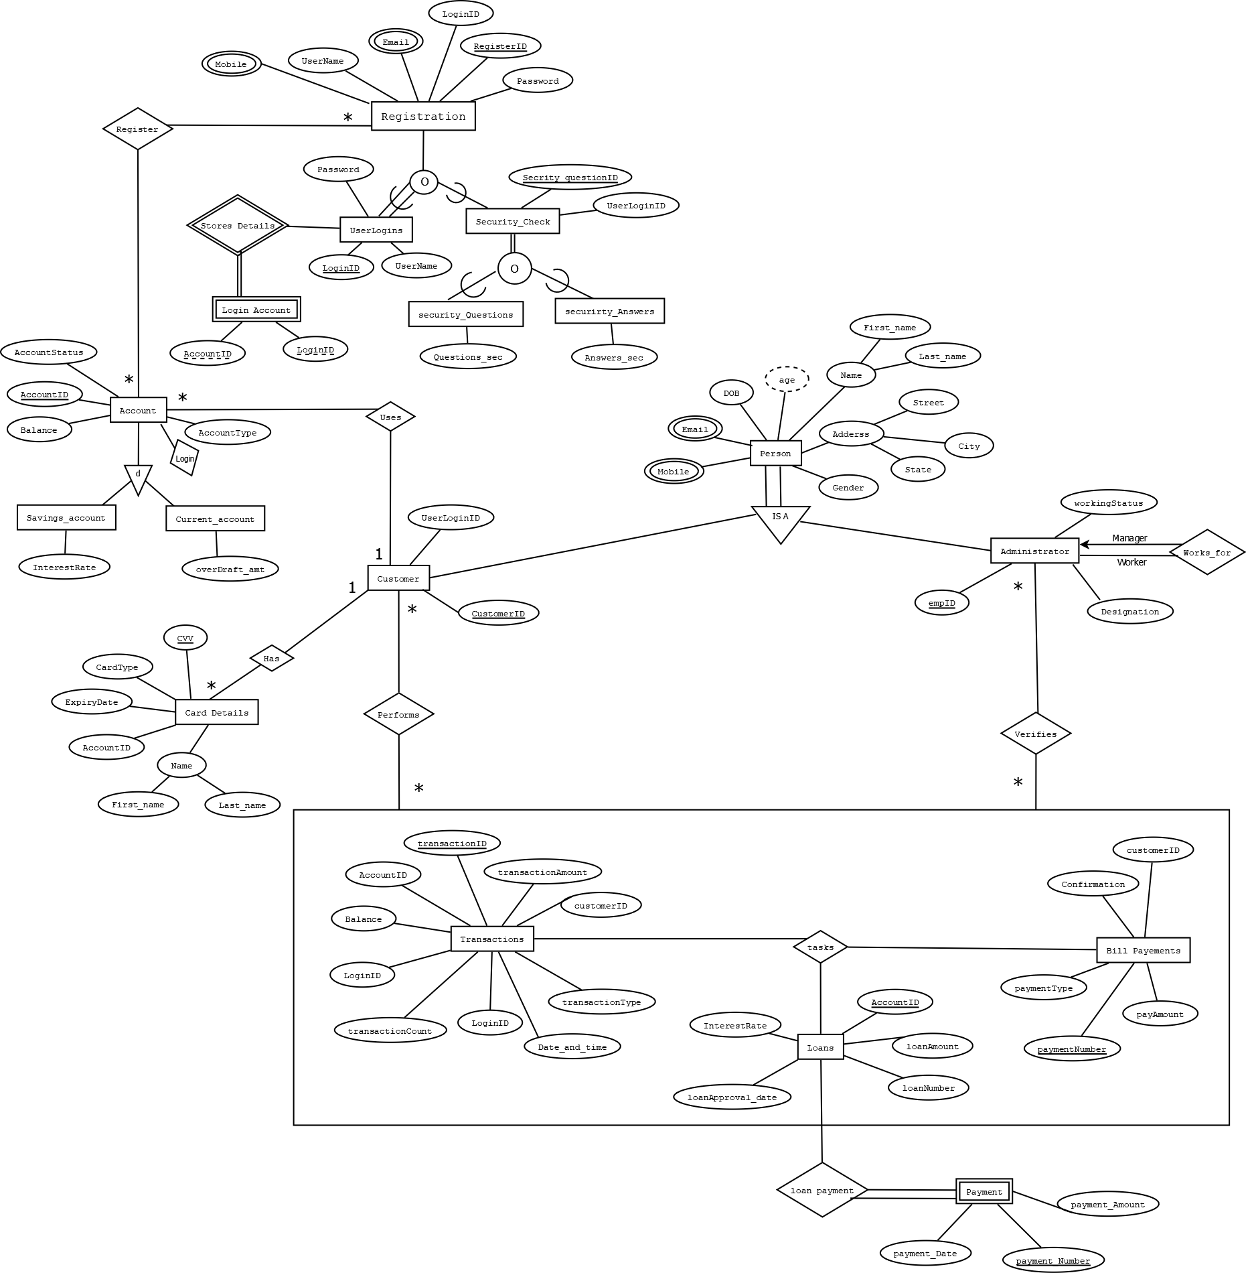

Slide 10
NORMALISATION

Slide 11
TABLES BEFORE NORMALISATION:
ADMINISTRATOR (Emp_id, Emp_firstName, Emp_lastName,
Emp_Gender, Emp_DOB,Emp_Designation, Emp_Designation, Hired_date, Emp_workingStatus)
CUSTOMER (Customer_id, AccountID, Customer_firstName,
Customer_lastName,Customer_Gender, DOB,
State,City, Customer_Address, Zip_code,Email_Id,
Mobile_no1,Mobile_no2, UserLoginID)
REGISTRATION (RegisterID, UserName, UserLoginID, Password, Email_Id, Mobile_no1)
LOGIN-ACCOUNT (UserLoginID, AccountID)
USERLOGINS (UserLoginID, UserName, Password)

Slide 12
CONT.
SECURITYANSWERS (UserLoginID, Security_Ans, Security_QuestID)
SECURITYQUESTIONS (Security_QuestID, Security_Questions)
TRANSACTION (TransactionID, TransactionDate, TransactionTime, TransactionType,
TransactionAmount, NewBalance, AccountID, Customer_id, UserLoginID,
WithdrawalCount, DepositCount)
LOAN-DETAILS (LoanNumber, AccountID, LoanAmount, InterestRate, LoanApprovalDate)
CARD-DETAILS (AccountID, CardHolder, CardType, CCV, ExpirtDate)
BILL-PAYMENTS (BillPayment_no, PaymentType, PaymentConfirmation, PaymentAmount, Customer_id)
FAILEDTRANSACTIONLOG (FailedTransaction_errorType, FailedTransactionID)

Slide 13
MASTER SCHEMA:
BANK (Emp_id, Emp_firstName, Emp_lastName, Emp_Gender, Emp_DOB, Emp_Designation, Hired_date, Emp_workingStatus, Emp_Mobile, Customer_id, AccountID, Customer_firstName, Customer_lastName, Customer_Gender, DOB, State, City, Customer_Address, Zip_code, Email_Id, Mobile_no, UserLoginID, AccountID, CurrentBalance, AccountType, AccountStatus, SavingsInterestRate, RegisterID, UserName, Password, Security_Ans, Security_QuestID, Security_Questions, TransactionID, TransactionDate, TransactionTime, TransactionType, TransactionAmount, NewBalance, WithdrawalCount, DepositCount, LoanNumber, LoanAmount, InterestRate, LoanApprovalDate, CardHolder, CardType, CCV, ExpirtDate, BillPayment_no, PaymentType, PaymentConfirmation, PaymentAmount, FailedTransaction_errorType, FailedTransactionID)

Slide 14
1 NF :
The relations should have primary keys
There should be no repeating groups
Decompose multi values attributes into new tables
Multivariable attributes:
TransactionID,
Mobile_no,
Emp_Mobile,
LoanNumber,
BillPayment_no.

Slide 15
Table 1:
BANK (Emp_id, Emp_firstName, Emp_lastName, Emp_Gender, Emp_DOB,
Emp_Designation, Hired_date, Emp_workingStatus, Customer_id,
AccountID, Customer_firstName, Customer_lastName, Customer_Gender,
DOB, State, City, Customer_Address, Zip_code, Email_Id,
UserLoginID, AccountID, CurrentBalance, AccountType, AccountStatus,
SavingsInterestRate, RegisterID, UserName, Password,
Security_Ans, Security_QuestID, Security_Questions, TransactionID,
TransactionDate, TransactionTime, TransactionType, TransactionAmount,
NewBalance, WithdrawalCount, DepositCount, LoanNumber,
LoanAmount, InterestRate, LoanApprovalDate, CardHolder, CardType,
CCV, ExpirtDate, BillPayment_no, PaymentType, PaymentConfirmation,
PaymentAmount, FailedTransaction_errorType, FailedTransactionID)

Slide 16
Table 2:
Cus_Mobile (Customer_id, Mobile_no)
Table 3:
Emp_Mob (Emp_id, Emp_Mobile)
Table 4:
Loan_num (Customer_id, LoanNumber)
Table 5:
Transact (AccountID, TransactionID)
Table 6:
Bill (AccountID, Bill_payment_no)

Slide 17
2 NF :
The tables are in 1NF
All the other non-prime attributes should be fully functionally dependent on Candidate keys.
Master Schema is decomposed and all the partial dependencies
are identified.

Slide 18
Table 1:
ADMINISTRATOR (Emp_id, Emp_firstName, Emp_lastName,
Emp_Gender, Emp_DOB, Emp_Designation,
Hired_date, Emp_workingStatus)
Functional Dependencies:
(Emp_id) --> (Emp_firstName, Emp_lastName, Emp_Gender, Emp_DOB, Emp_Designation,
Emp_workingStatus, Hired_date)
Table 2:
CUSTOMER (Customer_id, AccountID, UserLoginID, Customer_firstName, Customer_lastName,
Customer_Gender, DOB, State, City, Customer_Address, Zip_code, Email_Id, Mobile_no)
Functional Dependencies:
(Customer_id) -->(AccountID, UserLoginID, Customer_firstName, Customer_lastName,
Customer_Gender, DOB, State, City, Customer_Address, Zip_code, Email_Id)
Table 3:
ACCOUNT-DETAILS (AccountID, CurrentBalance, AccountType, AccountStatus, SavingsInterestRate)
Functional Dependencies:
(AccountID) --> (CurrentBalance, AccountType, AccountStatus, SavingsInterestRate)

Slide 19
Table 4:
REGISTRATION (RegisterID, UserName, UserLoginID, Password, Email_Id, Mobile)
Functional Dependencies:
(RegisterID, UserLoginID) -> (UserName, Password, Email_Id, Mobile)
Table 5:
TRANSACTION (TransactionID, TransactionDate, TransactionTime, TransactionType, TransactionAmount, NewBalance,
WithdrawalCount, DepositCount)
Functional Dependencies:
(TransactionID) -> (TransactionDate, TransactionTime, TransactionType, TransactionAmount, NewBalance, WithdrawalCount, DepositCount)
Table 6:
LOAN-DETAILS (LoanNumber, LoanAmount, InterestRate, LoanApprovalDate, LoanType)
Functional Dependencies:
(LoanNumber) -> (LoanAmount, InterestRate, LoanApprovalDate, LoanType)

Slide 20
Table 7:
CARD-DETAILS (CardNumber, CardHolder, CardType, CCV, ExpirtDate)
Functional Dependencies:
(CardNumber) -> (CardHolder, CardType, CCV, ExpirtDate)
Table 8:
BILL-PAYMENTS (BillPayment_no, PaymentType, PaymentConfirmation, PaymentAmount)
Functional Dependencies:
(BillPayment_no) -> (PaymentType, PaymentConfirmation, PaymentAmount)
Table 9:
FailedTransactionLog (FailedTransaction_errorType, FailedTransactionID)
Functional Dependencies:
(FailedTransactionID) -> (FailedTransaction_errorType)
Table 10:
USERLOGINS (UserLoginID, UserName, Password)
Functional Dependencies:
(UserLoginID) -> (Username, Password)

Slide 21
PARTIAL DEPENDENCY:
(5a) Security_Ans (UserLoginID, Security_QuestID, Security_Ans)
Functional Dependencies:
(UserLoginID, Security_QuestID) -> (Security_Ans)
(5b) Security_Quest (Security_QuestID, Security_Questions)
Functional Dependencies:
(Security_QuestID) -> (Security_Questions)

Slide 22
3 NF :
If it is in 2NF
There is no transitive functional dependency between non-prime attributes.
Further, the decomposed master schema should be segregated on the basis of transitive dependency.

Slide 23
Table 1:
ADMINISTRATOR (Emp_id, Emp_firstName, Emp_lastName, Emp_Gender, Emp_DOB, Emp_Designation,
Hired_date, Emp_workingStatus)
Functional Dependencies:
(Emp_id) -> (Emp_firstName, Emp_lastName, Emp_Gender, Emp_DOB, Emp_Designation, Emp_workingStatus, Hired_date)
Table 2:
CUSTOMER (Customer_id, AccountID, UserLoginID, Customer_firstName, Customer_lastName, Customer_Gender,
DOB, State, City, Customer_Address, Zip_code, Email_Id, Mobile_no)
Functional Dependencies:
(Customer_id) -> (AccountID, UserLoginID, Customer_firstName, Customer_lastName, Customer_Gender, DOB,
Customer_Address, Email_Id)
Table 3:
ACCOUNT-DETAILS (AccountID, CurrentBalance, AccountType, AccountStatus, SavingsInterestRate)
Functional Dependencies:
(AccountID) -> (CurrentBalance, AccountType, AccountStatus, SavingsInterestRate)

Slide 24
TABLE 4:
REGISTRATION (RegisterID, UserName, UserLoginID, Password, Email_Id, Mobile)
Functional Dependencies:
(RegisterID, UserLoginID) -> (UserName, Password, Email_Id, Mobile)
TABLE 5:
Security_Ans (UserLoginID, Security_QuestID, Security_Ans)
Functional Dependencies:
(UserLoginID, Security_QuestID) -> (Security_Ans)
TABLE 6:
Security_Quest (Security_QuestID, Security_Questions)
Functional Dependencies:
(Security_QuestID) -> (Security_Questions)
TABLE 7:
TRANSACTION (TransactionID, TransactionDate, TransactionTime, TransactionType, TransactionAmount, NewBalance,
WithdrawalCount, DepositCount, OldBalance)
Functional Dependencies:
(TransactionID) ->(TransactionDate, TransactionTime, TransactionType, TransactionAmount, NewBalance,
WithdrawalCount, DepositCount, OldBalance)

Slide 25
TABLE 8:
LOAN-DETAILS (LoanNumber,LoanAmount, InterestRate, LoanApprovalDate, LoanType)
Functional Dependencies:
(LoanNumber) -> (LoanAmount, InterestRate, LoanApprovalDate, LoanType)
TABLE 9:
CARD-DETAILS (CardNumber, CardHolder, CardType, CCV, ExpirtDate)
Functional Dependencies:
(CardNumber) -> (CardHolder, CardType, CCV, ExpirtDate)
TABLE 10:
BILL-PAYMENTS (BillPayment_no, PaymentType, PaymentConfirmation, PaymentAmount)
Functional Dependencies:
(BillPayment_no) -> (PaymentType, PaymentConfirmation, PaymentAmount)
TABLE 11:
FailedTransactionLog (FailedTransaction_errorType, FailedTransactionID)
Functional Dependencies:
(FailedTransactionID) -> (FailedTransaction_errorType)
TABLE 12:
USERLOGINS (UserLoginID, UserName, password)

Slide 26
TRANSITIVE DEPENDENCY:
7a) LOANTYPE (Loan_Type, InterestRate)
Functional Dependencies:
(Loan_Type) --> (InterestRate)
7b) LOAN-DETAILS (LoanNumber, LoanAmount, LoanApprovalDate, LoanType)
Functional Dependencies:
(LoanNumber) --> (LoanAmount, LoanApprovalDate, LoanType)
2a) CUSTOMER (Customer_id, AccountID, UserLoginID, Customer_firstName, Customer_lastName, Customer_Gender, DOB, Customer_Address, Email_Id, Mobile_no)
Functional Dependencies:
(Customer_id) --> (AccountID, UserLoginID, Customer_firstName, Customer_lastName, Customer_Gender, DOB, Customer_Address, Email_Id, Zip_code)
2b) State_city (City,State)
Functional Dependencies:
(City) --> (State)
2c) Zip (Zip_code, City)
Functional Dependencies:
(Zip_code) --> (City)

Slide 27
BCNF
1. Above relations are in 3NF.
2. In the above relations, one can see that only the super
key determines all the other attributes in that relation.
Therefore, so all the relations are in BCNF.

Slide 28
FINALIZED TABLES:
1) ADMINISTRATOR (Emp_id, Emp_firstName, Emp_lastName, Emp_Gender, Emp_DOB, Emp_Designation, Hired_date, Emp_workingStatus)
2) CUSTOMER (Customer_id, AccountID, UserLoginID, Customer_firstName, Customer_lastName, Customer_Gender, DOB, Customer_Address, Zip_code, Email_Id, Mobile_no)
3) ACCOUNT-DETAILS (AccountID, CurrentBalance, AccountType, AccountStatus, SavingsInterestRate)
4) REGISTRATION (RegisterID, UserName, UserLoginID, Password, Email_Id, Mobile)
5) SECURITY_ANSS (UserLoginID, Security_QuestID, Security_Ans)

Slide 29
6) SECURITY_QUEST (Security_QuestID, Security_Questions)
7) TRANSACTION (TransactionID, TransactionDate, TransactionTime, TransactionType, TransactionAmount, NewBalance, WithdrawalCount, DepositCount, OldBalance)
8) LOANTYPE (Loan_Type, InterestRate)
9) LOAN-DETAILS (LoanNumber, LoanAmount, LoanApprovalDate, LoanType)
10) CARD-DETAILS (CardNumber, CardHolder, CardType, CCV, ExpirtDate)
11) BILL-PAYMENTS (BillPayment_no, PaymentType, PaymentConfirmation, PaymentAmount)
12) FailedTransactionLog (FailedTransaction_errorType, FailedTransactionID)

Slide 30
13) USERLOGINS (UserLoginID, UserName, password)
14) Cus_Mobile (Customer_id, Mobile_no)
15) Emp_Mob (Emp_id, Emp_Mobile)
16) Loan_num (Customer_id, LoanNumber)
17) Transact (AccountID, TransactionID)
18) Bill (AccountID, Bill_payment_no)
19) State_city (City,State)
20) Zip (Zip_code, City)

Slide 31
CREATION OF TABLES

Slide 32
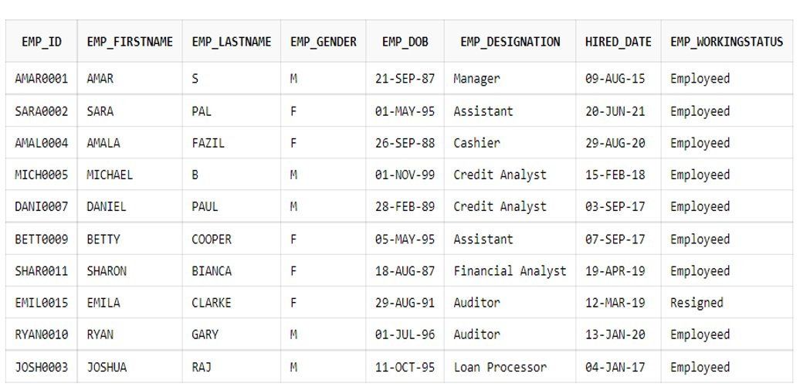
ADMINISTRATOR TABLE Create TABLE ADMINISTRATOR (Emp_id varchar(10) PRIMARY KEY, Emp_firstName varchar(30), Emp_lastName varchar(30), Emp_Gender char(1), Emp_DOB date, Emp_Designation varchar2(20),Hired_date date, Emp_workingStatus varchar2(20));

Slide 33
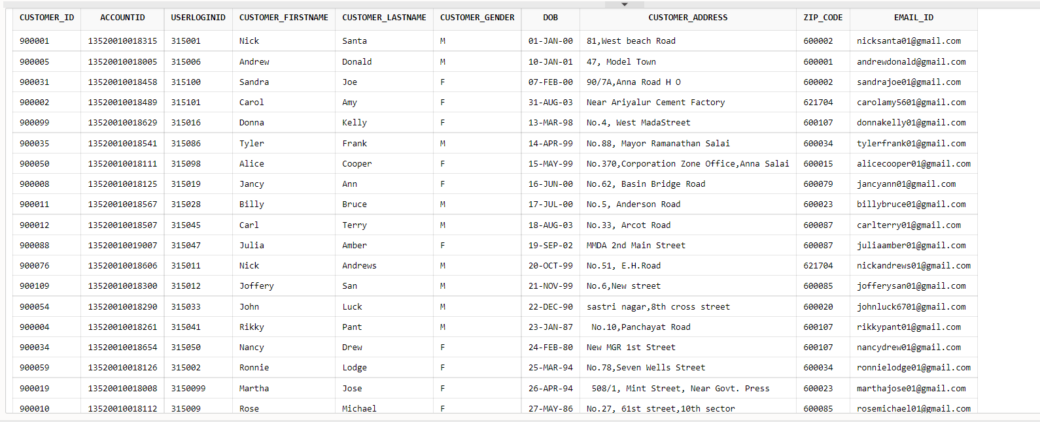
CUSTOMER TABLE Create Table CUSTOMER (Customer_id int PRIMARY KEY, AccountID varchar(20), UserLoginID int, Customer_firstName varchar(30), Customer_lastName varchar(30), Customer_Gender char(1), DOB date , Customer_Address varchar2(100), Zip_code int, Email_Id varchar(30));

Slide 34
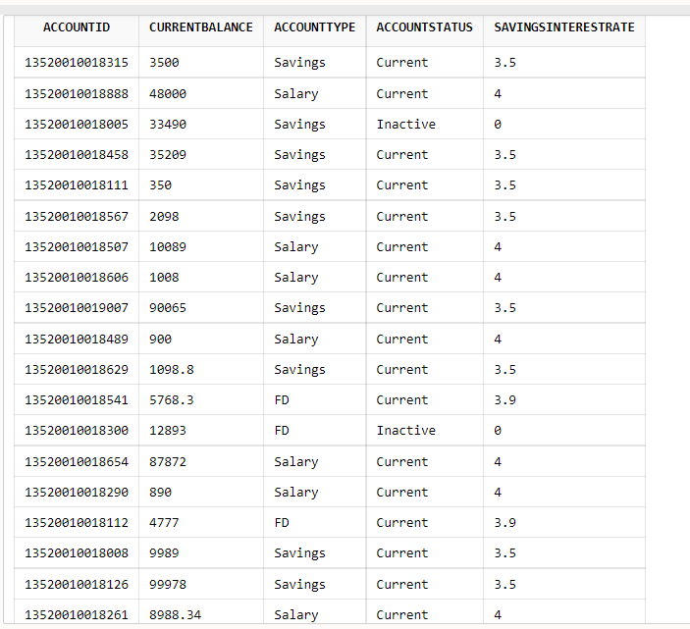
ACCOUNT_DETAILS Create table ACCOUNT_DETAILS (AccountID varchar(20) PRIMARY KEY, CurrentBalance float, AccountType varchar2(20), AccountStatus varchar2(20), SavingsInterestRate float);

Slide 35
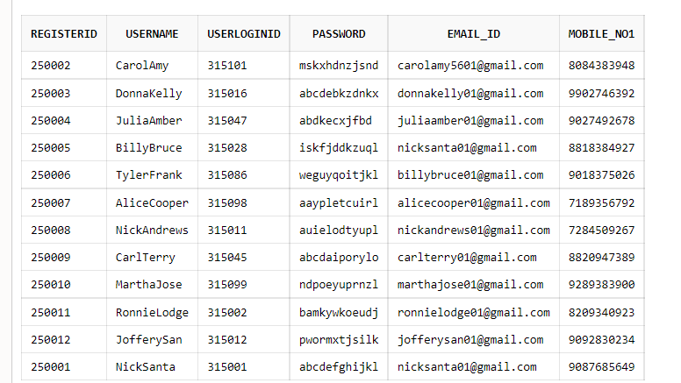
REGISTRATION Create table REGISTRATION (RegisterID int PRIMARY KEY, UserName varchar(20), UserLoginID int, Password varchar(12), Email_Id varchar(30), Mobile_no1 number(10));

Slide 36
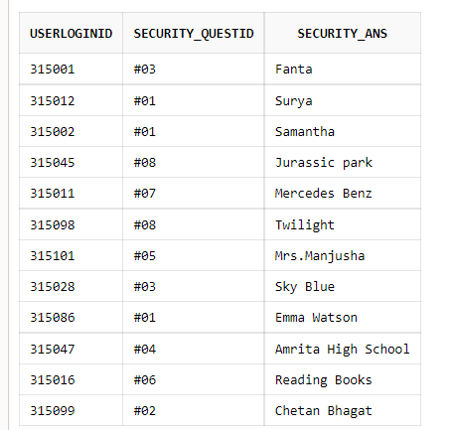
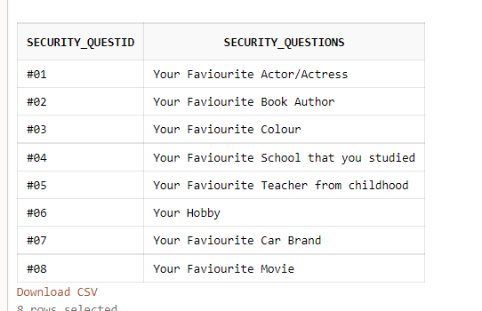
SECURITY QUESTION AND ANSWER Create Table SECURITY_ANSS (UserLoginID int PRIMARY KEY, Security_QuestID varchar(3), Security_Ans varchar(20)); Create Table SECURITY_QUEST (Security_QuestID varchar(3) PRIMARY KEY, Security_Questions varchar(50));

Slide 37
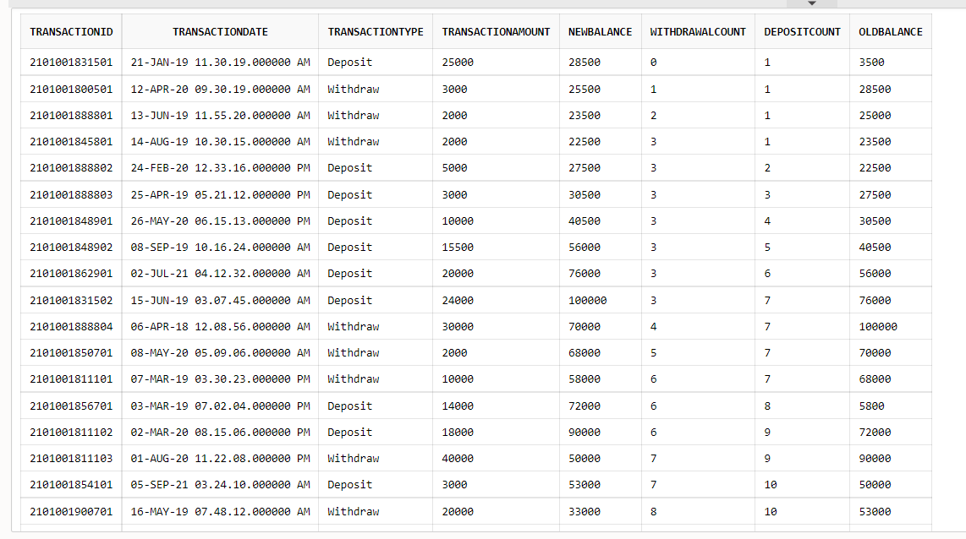
TRANSACTION Create table TRANSACTION (TransactionID varchar(15) PRIMARY KEY, TransactionDate date, TransactionTime timestamp, TransactionType varchar2(20), TransactionAmount float, NewBalance float, WithdrawalCount int, DepositCount int, OldBalance float);

Slide 38
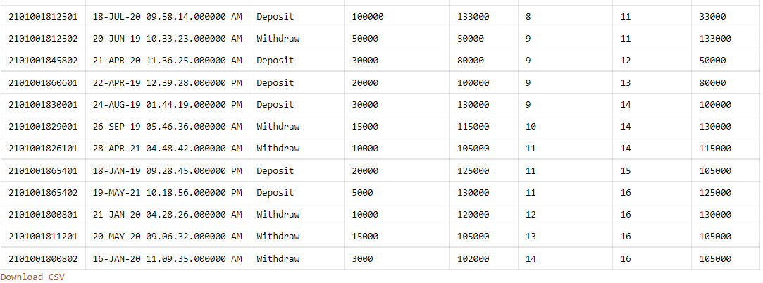
CONDT....

Slide 39
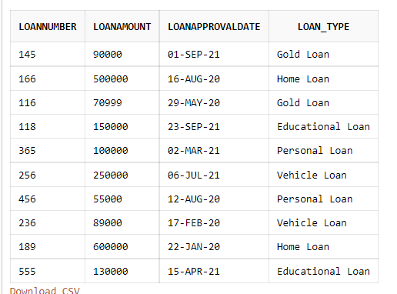
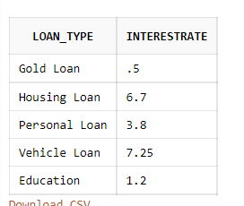
LOANTYPE AND LOAN_DETAILS Create table LOANTYPE (Loan_Type varchar2(20) PRIMARY KEY, InterestRate float); Create table LOAN_DETAILS (LoanNumber int PRIMARY KEY, LoanAmount float, LoanApprovalDate date, Loan_Type varchar2(20)) ;

Slide 40
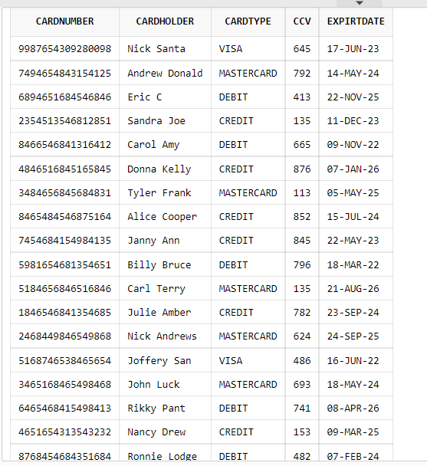
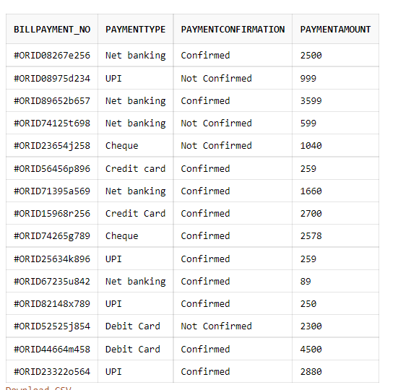
CARD_DETAILS AND BILL_PAYMENTS Create table CARD_DETAILS (CardNumber varchar(16) PRIMARY KEY, CardHolder varchar2(20), CardType varchar(20), CCV number(3), ExpirtDate date) ; Create table BILL_PAYMENTS (BillPayment_no varchar(20) PRIMARY KEY, PaymentType varchar(30),PaymentConfirmation varchar(15), PaymentAmount float);

Slide 41
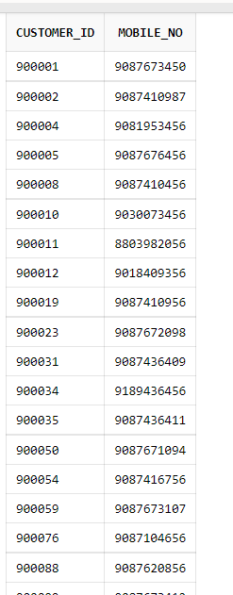
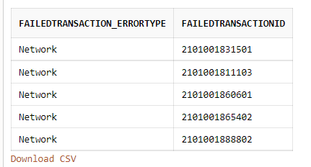
FAILEDTRANSACTIONLOG AND CUS_MOBILE Create table FailedTransactionLog (FailedTransaction_errorType varchar(30), FailedTransactionID varchar(15) PRIMARY KEY) ; Create table Cus_Mobile (Customer_id int, Mobile_no number(10),PRIMARY KEY (Customer_id,Mobile_no));

Slide 42
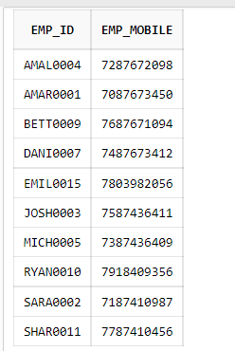
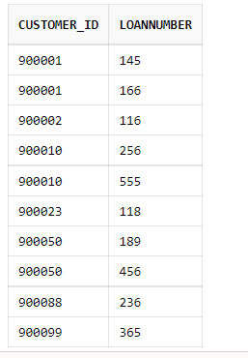
EMP_NUMBER AND LOAN_CUSTOMER Create table Emp_Mob(Emp_id varchar(10), Emp_Mobile number(10),PRIMARY KEY (Emp_id, Emp_Mobile) ); Create table Loan_num(Customer_id int, LoanNumber int,PRIMARY KEY (Customer_id,LoanNumber));

Slide 43
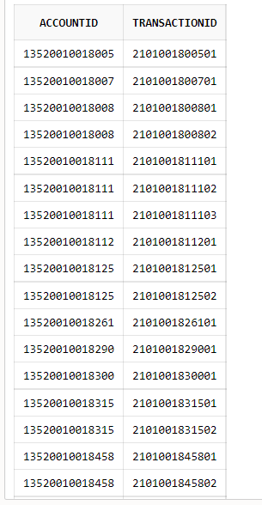
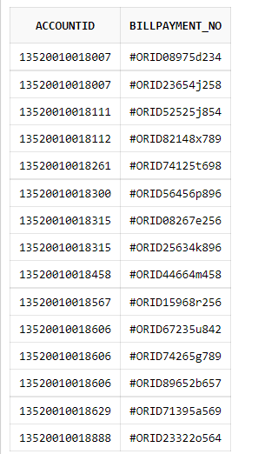
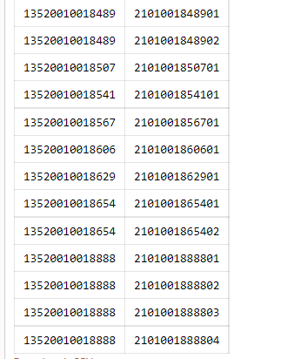
TRANSACT AND BILL Create table Transact (AccountID varchar(20), TransactionID varchar(15), PRIMARY KEY (AccountID,TransactionID)); Create table Bill (AccountID varchar(20), Billpayment_no varchar(20), PRIMARY KEY (AccountID,Billpayment_no));

Slide 44
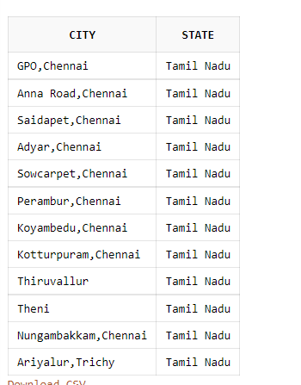
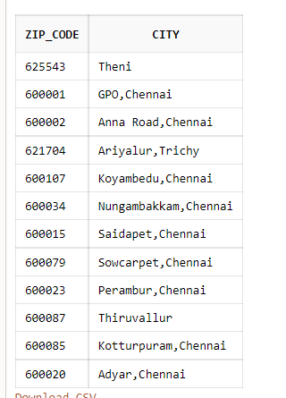
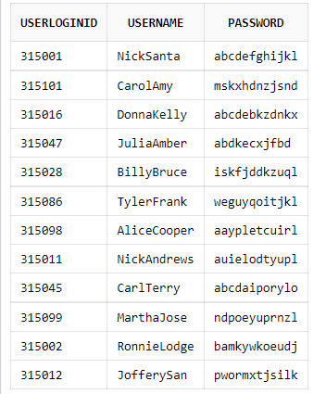
STATE_CITY , ZIP AND USERLOGINS Create Table State_city(City varchar2(20),State varchar2(20)); Create table Zip (Zip_code int, City varchar2(20)); Create Table USERLOGINS (UserLoginID int PRIMARY KEY, UserName varchar(20), password varchar(12));

Slide 45
USER INTERFACE

Slide 46
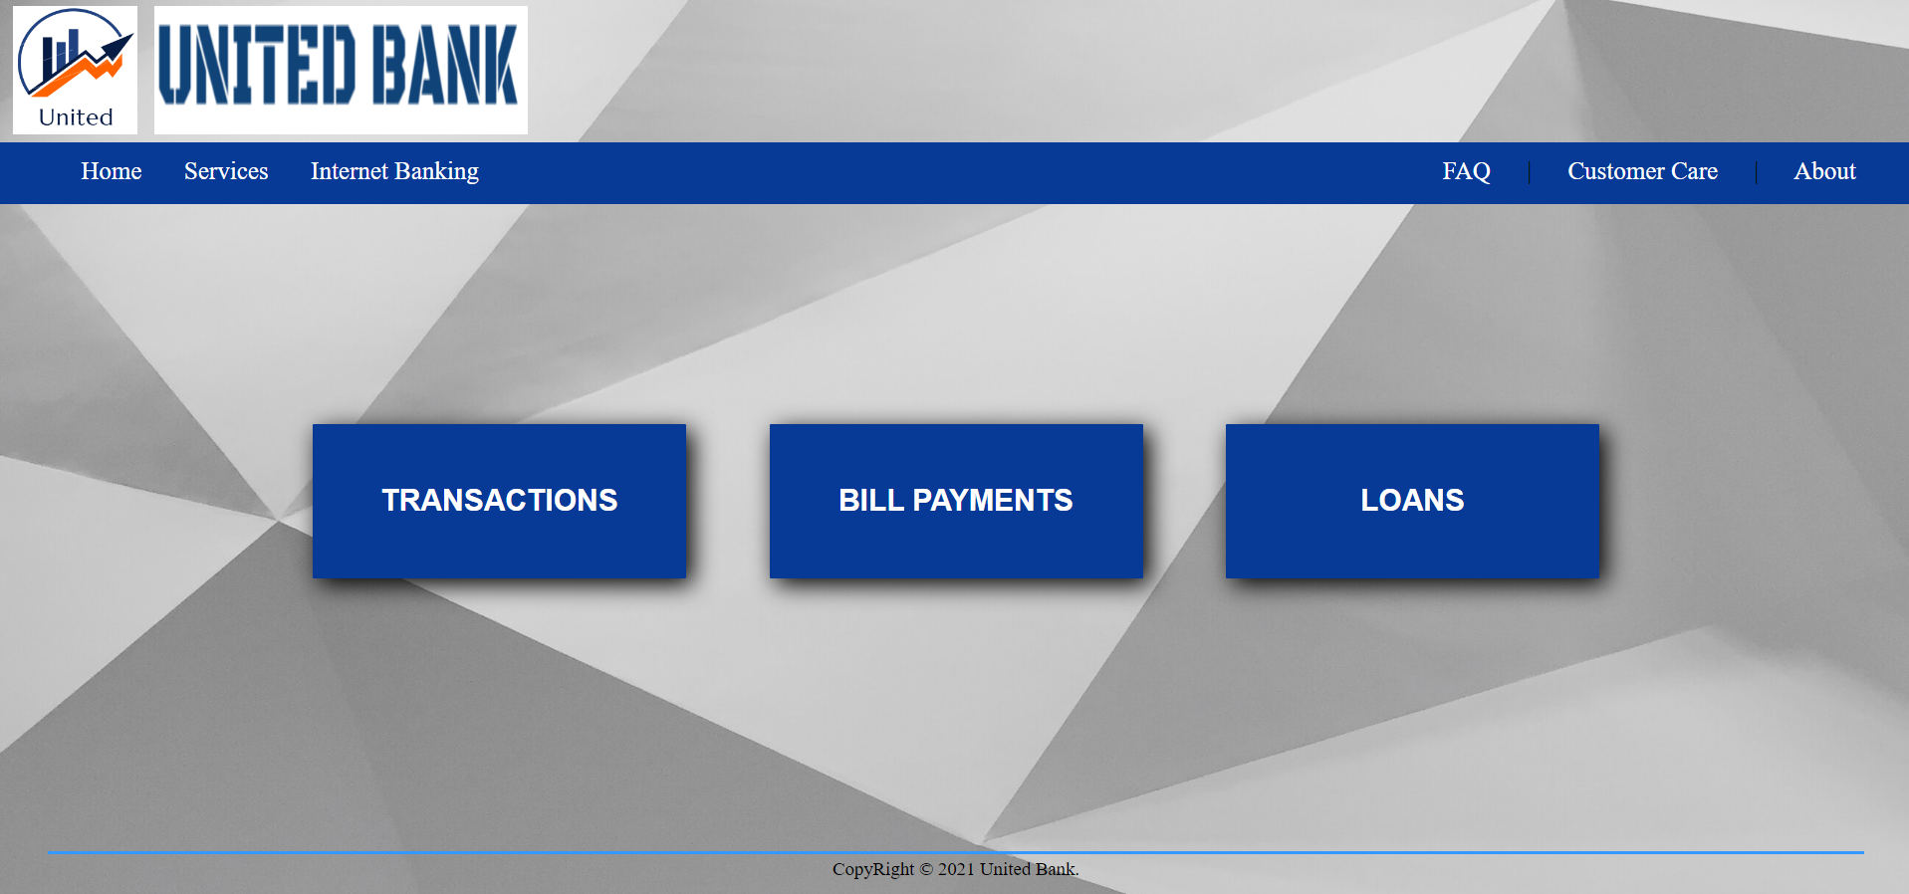
HomePage

Slide 47
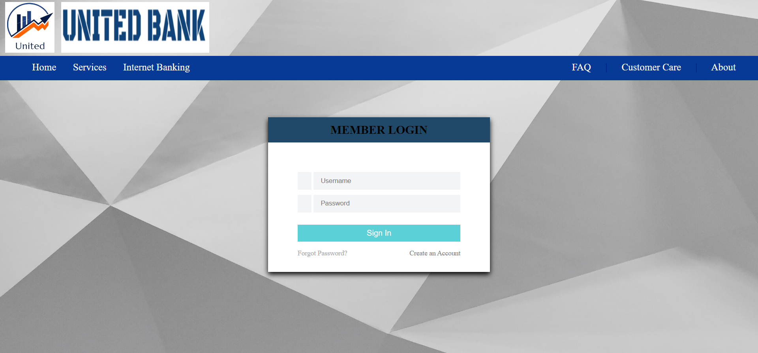
Admin Login

Slide 48
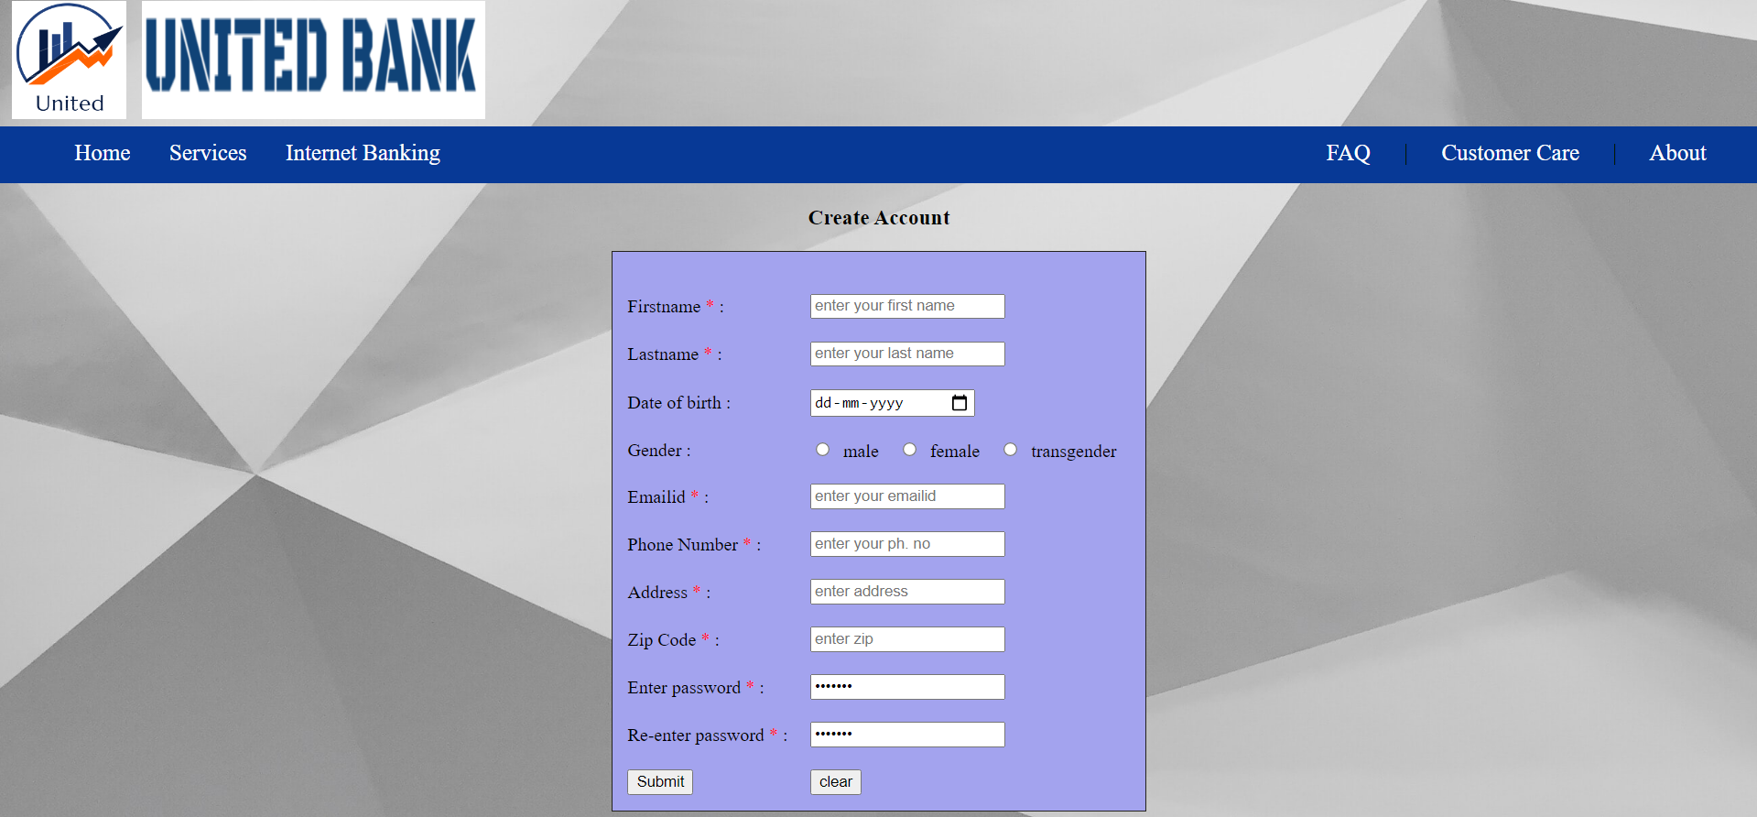
Registration

Slide 49
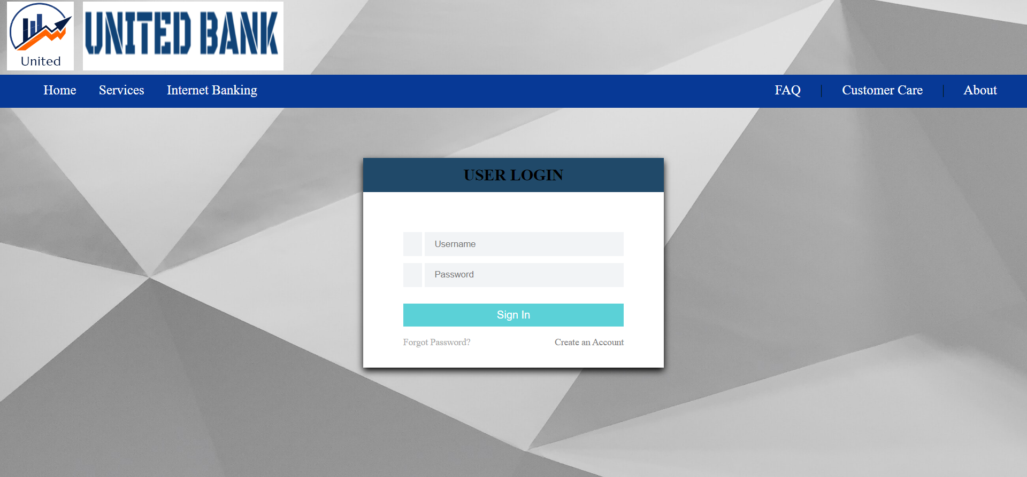
User Login

Slide 50
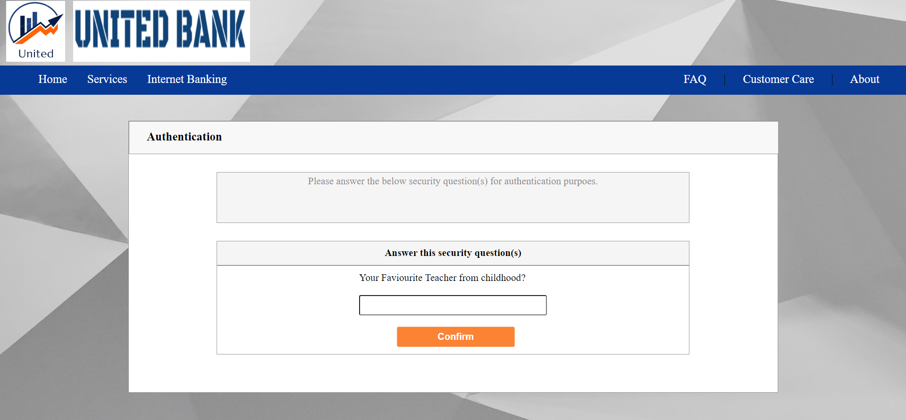
Security Check

Slide 51
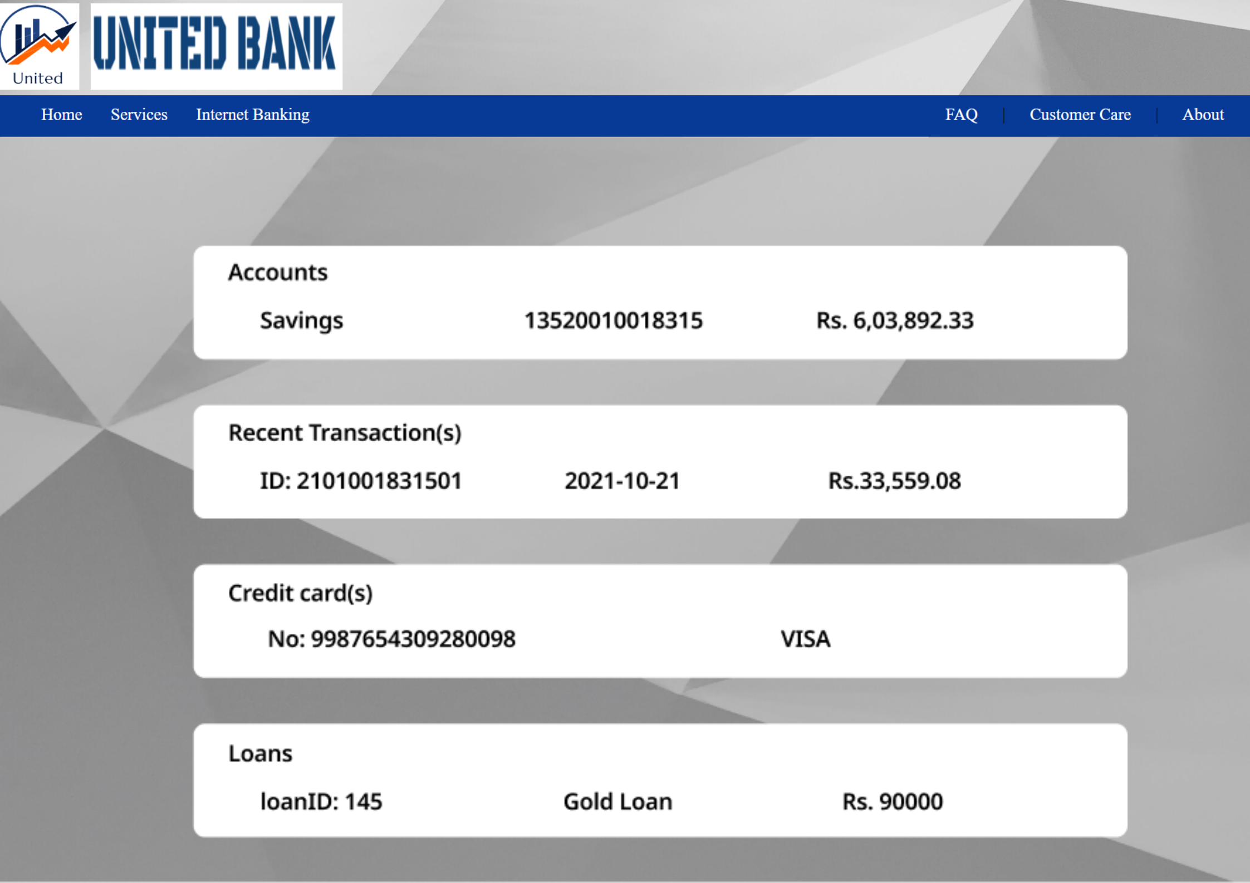
User Acc (sample user)

Slide 52
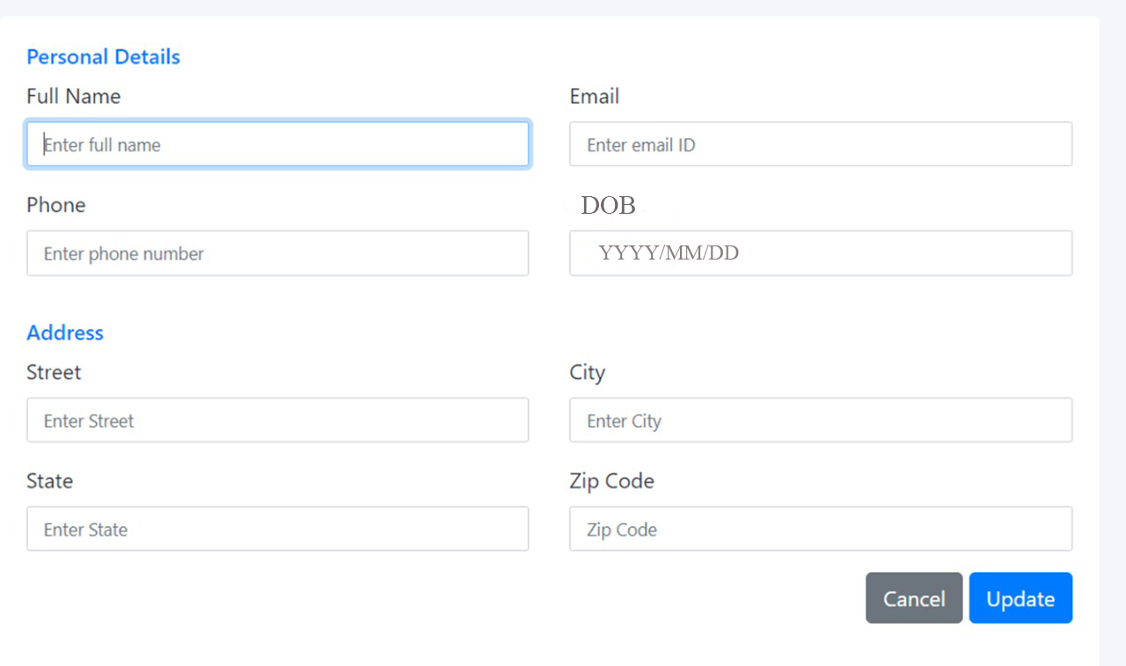
User Details Updation

Slide 53
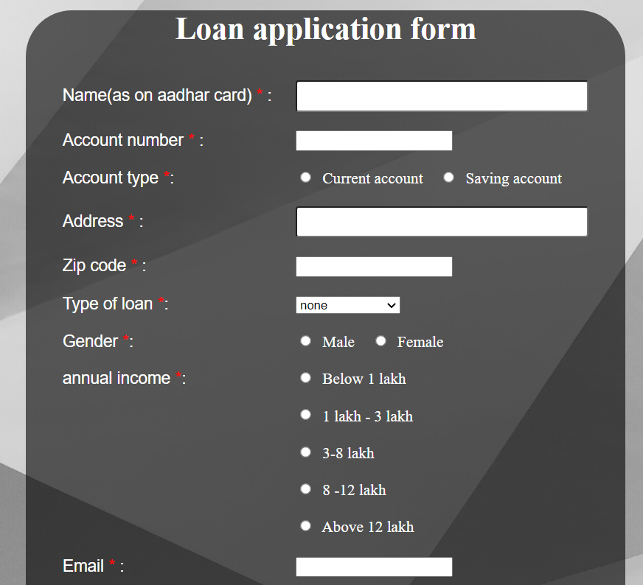
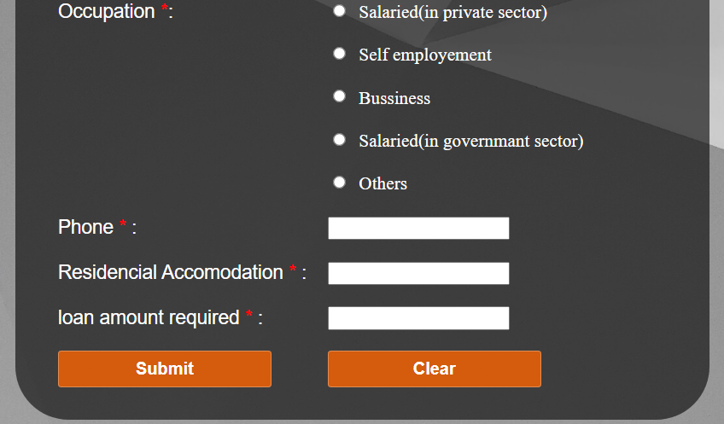
Loan Form

Slide 54
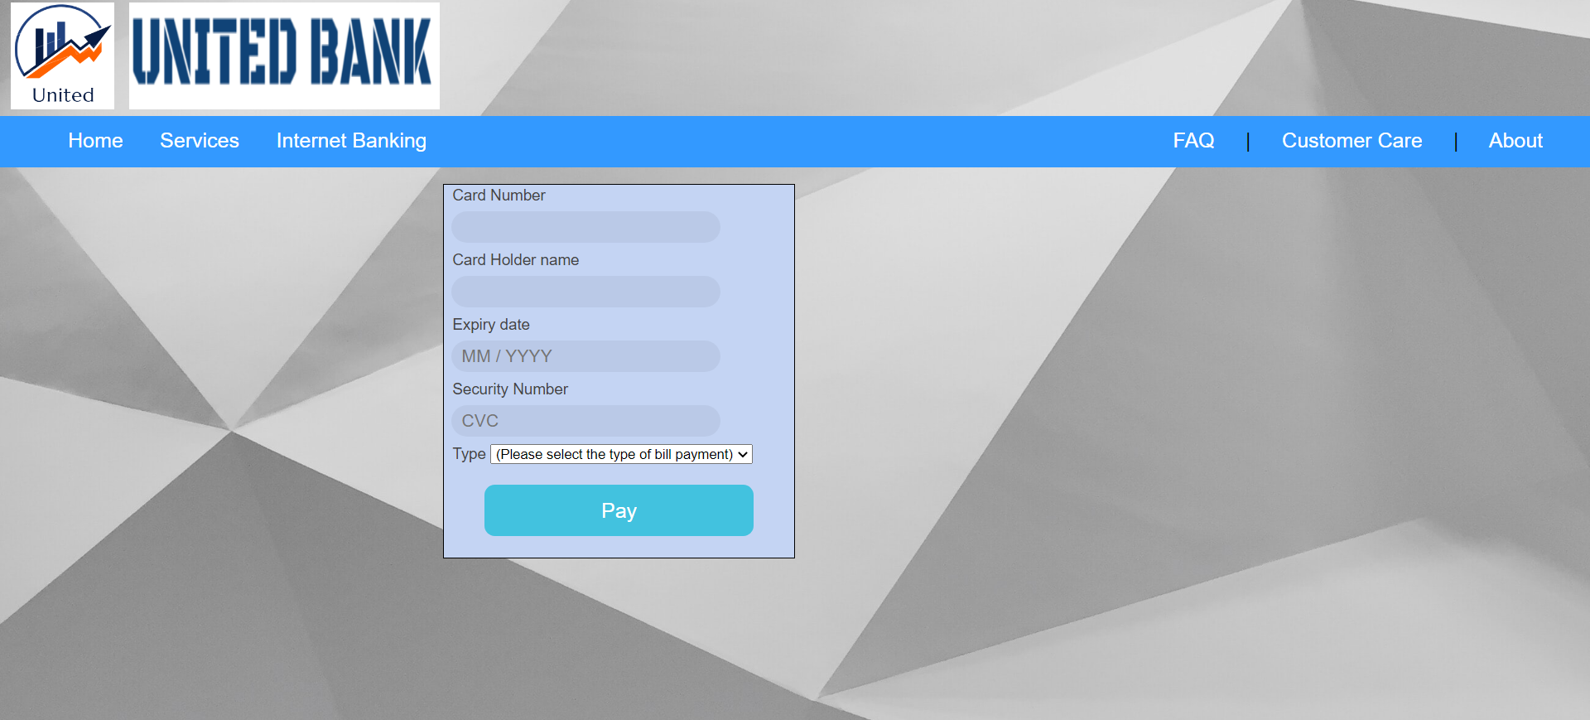
Bill Payment

Slide 55
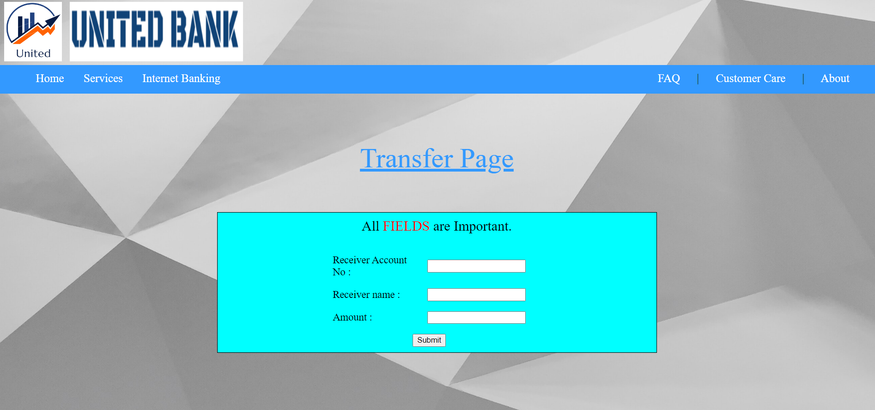
Transfer Page

Slide 56
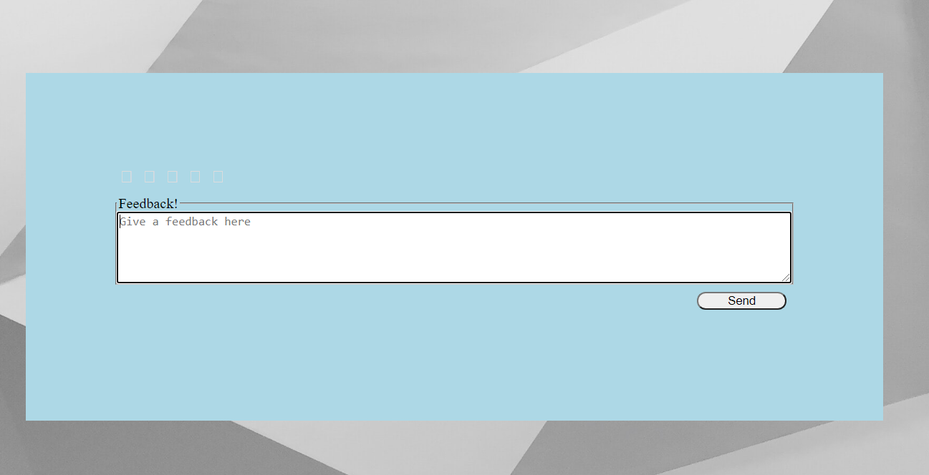
Feedback

Slide 57
CONCLUSION//

Slide 58
TEAM MEMBERS
S.NO | NAME | ROLL NUMBER | WORK DONE
1 | SHARON BIANCA R | CB.EN.U4CSE20258 | Normalization, Table Creation And Documentation
2 | TEJASWINI BOYAPATI | CB.EN.U4CSE20266 | UI Design, EER And Documentation
3 | ASHISH YENEPURI | CB.EN.U4CSE20271 | UI Design
4 | NITHEESH M | CB.EN.U4CSE20244 | UI Design And EER

Slide 59

THANK YOU

